Slide 1

A SERMON PRESENTATION
Making Room for the Upgrade
God sometimes removes or "uninstalls" the old to prepare us for divine upgrades.
McTerence Hembah
6th October, 2025

Slide 2

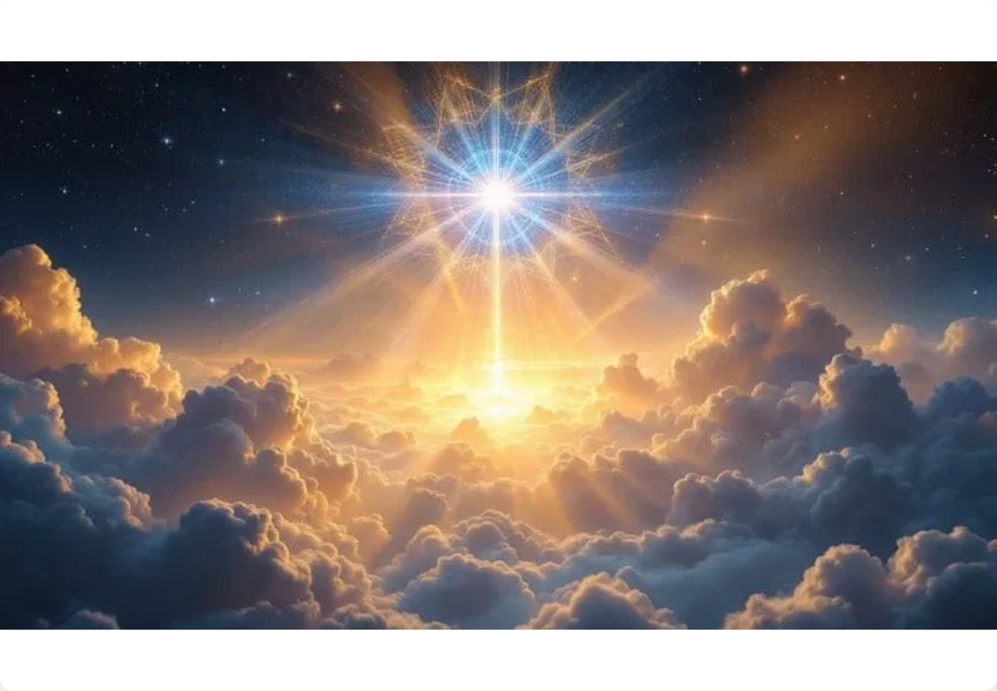
Anchor Text
"Behold, I will do a new thing; now it shall spring forth; shall ye not know it?"
— Isaiah 43:19 (KJV)
"He takes away the first, that He may establish the second."
— Hebrews 10:9

Slide 3




1. God Is the Master Engineer
Every software has a developer.
Every life has a Designer — God.
"You're not malfunctioning — you're under maintenance!"
He knows your system capacity and what version you're running.
Sometimes He says, "It's time for version 2.0."

Slide 4




2. Before Every Upgrade, There's a Cleanup
Before installing a new app, you delete some old files.
"He prunes every branch that bears fruit, so it can bear more."
— John 15:2
Before God pours in new blessings, He clears out clutter — relationships, habits, even possessions.
"Stop crying over what God uninstalled — it was slowing your system down!"
The uninstallation hurts, but it's necessary.

Slide 5



3. Compatibility Matters
Some blessings won't run on your current mindset.
"You can't run Windows 11 blessings on a Windows XP attitude."
You need a system update — renewed thinking, deeper faith, better discipline.
"Be transformed by the renewing of your mind."
— Romans 12:2

Slide 6




4. The Installation Process
It takes time. The screen may go blank. Don't panic.
"He who began a good work in you will carry it on to completion."
— Philippians 1:6
Silence doesn't mean God has stopped working; it means He's loading something bigger.
"God's progress bar may look stuck, but trust me — Heaven's still installing!"
Trust the process — "Please do not turn off your system while upgrade is in progress."

Slide 7



5. The New Version
When God finishes, the new version of you will run smoother, faster, and stronger.
"If anyone is in Christ, he is a new creation."
— 2 Corinthians 5:17
"Don't mourn what was deleted — celebrate what's being downloaded."
You'll look back and realize why the old had to go.
New grace. New mindset. New level.

Slide 8
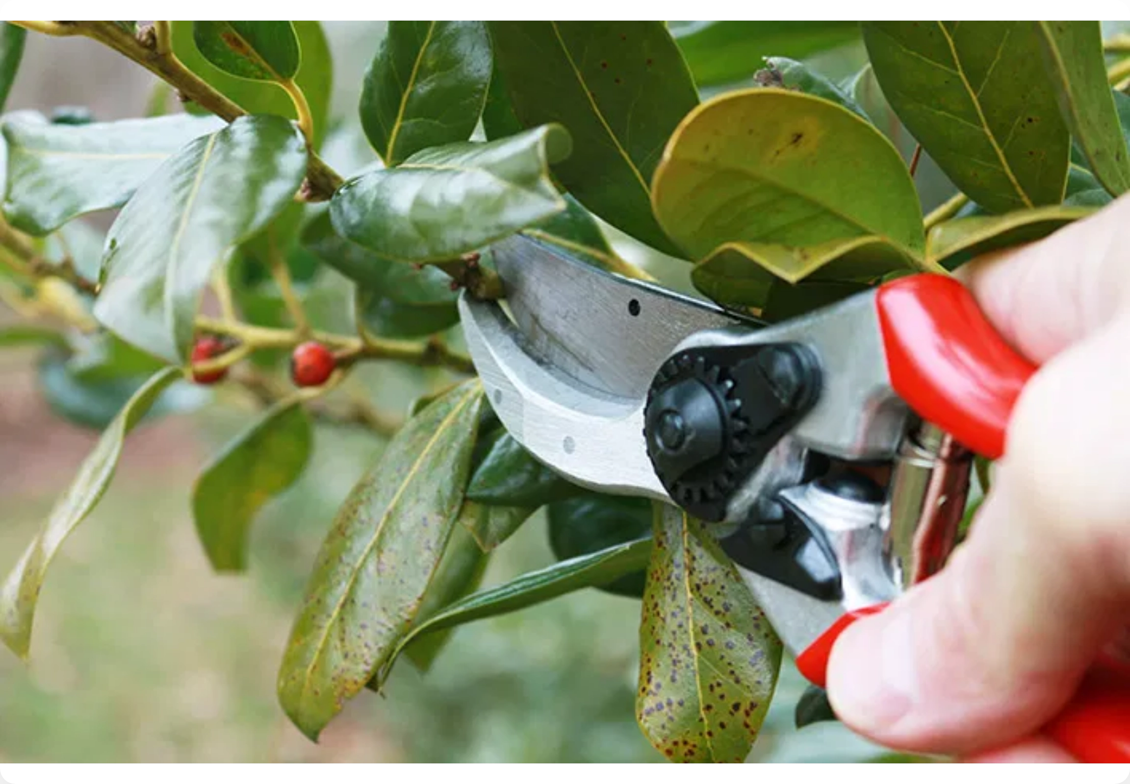
Closing Word
"God wants to
upgrade your
life
, but He needs
permission
."
to access your system
"Will you say,
'Lord, install Your
will in me today'
?"

